Slide 1
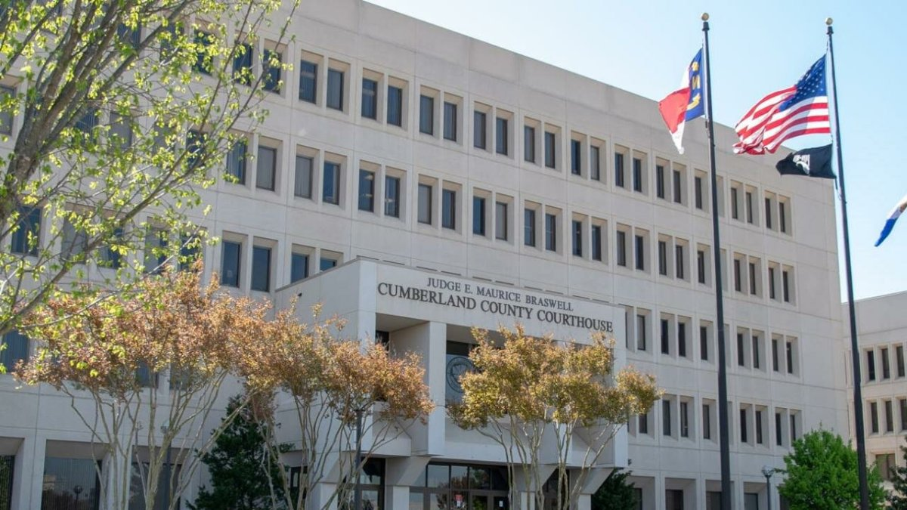
2025
Revaluation Results
February 13, 2025

Slide 2
Overview
General Information about Revaluation
Revaluation Results
Details of the Assessed Value
Communicating with Taxpayers
Appeal Support
Tax Relief Available
Schedule / Key Deadlines
Contact Information

Slide 3
General Information
Required by NC General Statutes (NCGS 105-286)
North Carolina law requires all counties to revalue real property at least once every 8-years.
Cumberland County is currently on an 8-year cycle – last revaluation was 2017.
Revaluation is simply…the process of updating Cumberland County’s real property values to reflect fair market value as of January 1, 2025.
Property tax values generally do not change from year to year until the next revaluation. Exceptions would include construction/renovations.

Slide 4
Revaluation Objective
Appraise all real property in the county at 100% of its market value, as defined by statute.
NCGS 105-283: “all property, real and personal, shall as far as practicable be appraised or valued at its true value in money.”
True value in money equals “market value”
True value in money is “the price estimated in terms of money at which the property would change hands between a willing and financially able buyer and seller, neither being under any compulsion to buy or sell and both having reasonable knowledge of all the uses to which the property is adapted and for which it is capable of being used.”
Tax Equity and Fairness
Revaluation ensures property values accurately reflect fair market value; ensuring the property tax burden is spread equitably across all taxpayers.
Revaluations are not conducted to raise revenue.

Slide 5
Revaluation Includes:
General Revaluations are conducted by applying mass appraisal techniques in conjunction with computer-assisted mass appraisal (CAMA) software.
Note: Cumberland County went live with a new software system February 2020
Vacant & improved property sales reviewed/analyzed.
Transactions that are consistent with the statue are qualified and used for sales analysis
For the 2025 revaluation, we considered over 45,000 qualified sales in analyzing market patterns and trends
Residential, commercial and industrial properties – all real property.
Market, cost and income models are developed.
The sales comparison approach is used on most residential properties.
The income approach is used on commercial income producing properties.

Slide 6
Assessed Value vs Taxable Value
Total 2025 Assessed Value: | $39,306,445,064
Minus Total Exemptions/Exclusions: | <$4,728,750,096>
Total 2025 Beginning Taxable Value: | $34,577,694,968
The 2025 beginning taxable value can be increased/reduced by:
New applications for exemptions/exclusions/deferments
Elderly Exclusions
Disabled Exclusions
Disabled Veterans Exclusions
Builder’s Inventory
Present Use Value Deferment Program
Results of appeals
Legislative Initiatives

Slide 7
The Bottom Line
Countywide, the total real property assessed value has increased by 64.7%
January 1, 2025, increase in Assessed Value: $15,438,928,797
Total 2024 Assessed Value (2017 rates) | Total 2025 Beginning Assessed Value | Percent Change
$23,867,516,267 | $39,306,445,064 | 64.7%

Slide 8
Details of the
Assessed Value

Slide 9
Results by Property Type
Real Property Component | Overall Change
Residential | 86.2%
Commercial | 27.0%
Total | 64.7%

Slide 10
Residential Results
Residential Component | Overall Change
Single Family | 84.2%
Multi-Family | 167.1%
Condominiums | 121.2%
Residential Vacant Land | 63.0%

Slide 11
Commercial Results
Commercial Component | Overall Change
Income Properties | 33.4%
Other Improved Commercial | 22.1%
Commercial Vacant Land | 40.8%
Industrial Properties | 18.5%

Slide 12
Percent Change by Municipality
Municipality | Overall Change
Fayetteville | 61.1%
Hope Mills | 70.8%
Spring Lake | 62.0%
Stedman | 62.6%
Wade | 74.8%
Falcon | 57.7%
Godwin | 107.0%
Linden | 73.0%
Eastover | 64.9%

Slide 13
Property Type Change by Municipality
Municipality | Residential Change | Commercial Change | Overall Change
Fayetteville | 88.4% | 27.5% | 61.1%
Hope Mills | 88.3% | 38.3% | 70.8%
Spring Lake | 121.0% | 37.2% | 62.0%
Stedman | 77.3% | 22.6% | 62.6%
Wade | 86.4% | 32.1% | 74.8%
Falcon | 103.6% | 25.8% | 57.7%
Godwin | 116.1% | 47.2% | 107.0%
Linden | 96.4% | 27.7% | 73.0%
Eastover | 72.1% | 22.1% | 64.9%

Slide 14
Communicating with Taxpayers
The Tax Valuation Notice
Being Mailed on February 21st
2025 Value & Legal Description (Both Sides)
Where to find information on the website (Front)
Instructions on how to submit an informal appeal (Front)
An “Informal Appeal Form” (Back)
“Frequently Asked Questions” Brochure
Call Center available to answer questions
Press Releases will be sent out (when mailed, appeals, deadlines)
Reappraisal Information Page on the Tax Website
Videos on the Tax Website

Slide 15
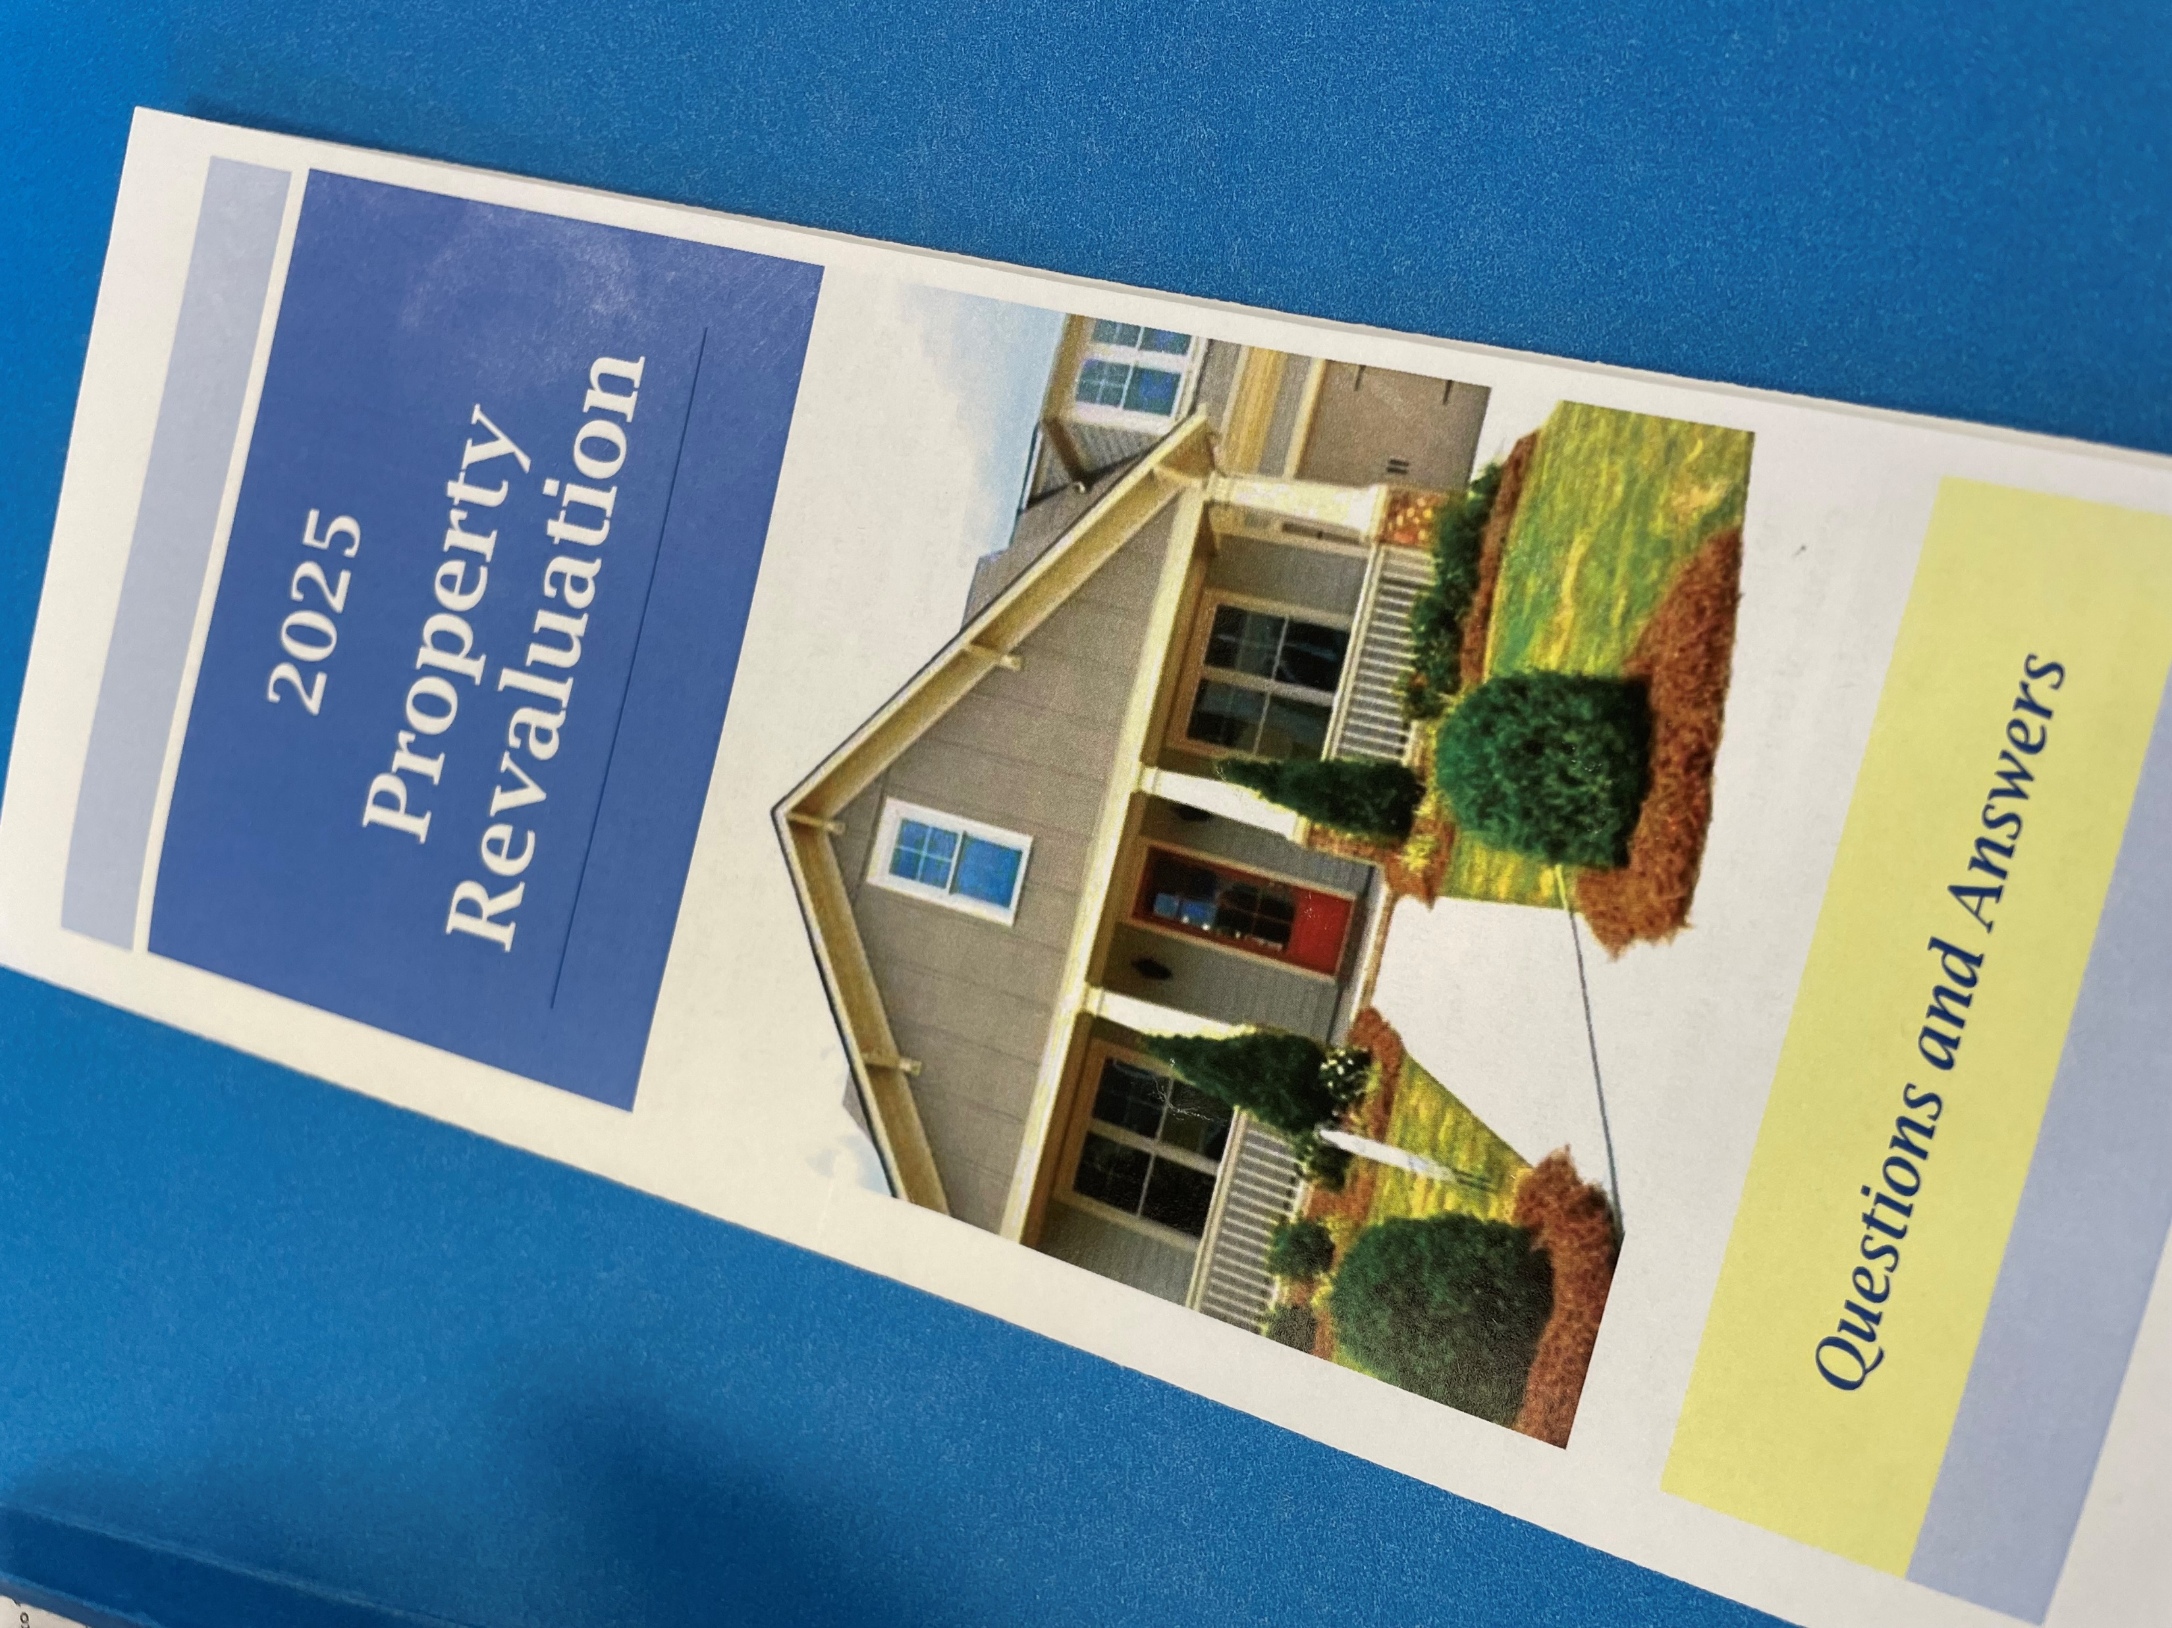
Frequently Asked Questions Brochure
Included in each “Valuation Notice”
Answers questions like:
What does the Valuation Notice mean?
What is revaluation?
Who decides the value of my property?
What is market value?
What can I do if I disagree with the assessed value of my property?
What happens after I appeal?

Slide 16
Revaluation Call Center
Call Center available: February 24 – March 24
Call Center Number: 910-678-7800
8:00-5:00 (Mon, Wed, Fri) & 8:00-7:00 (Tue, Thu)
Appraisers in the Call Center will be able to:
Explain the reappraisal process
Review the Tax Valuation Notice and property record card
Answer basic questions about the assessed value
Schedule an appointment to meet with an appraiser
Explain how to submit a written informal appeal
Explain what information will help the taxpayer support their appeal

Slide 17
Appeal Support
Property Owners are requested to take these steps before appealing:
Review our records for their property and report any updates;
Compare their tax value with actual sales prices of similar properties; and
If they believe their property value is incorrect, they are encouraged to submit an informal appeal.
NOTE: Property records can be reviewed at the public website https://taxpwa.co.cumberland.nc.us/camapwa/ or by talking with an appraiser through the call center or coming into the office.
Residential documentation that supports a different value includes:
Recent fee appraisal
Comparative Market Analysis
Comparable sales data collected by property owner
Pictures showing the condition of the property

Slide 18
Appeal Support (cont.)
Commercial documentation that supports a different value includes:
Same as for a residential property, but should also include:
Income and expense information for the 3-years prior to the revaluation
In all cases, the property owner can provide anything they deem important
Important to Remember:
Percent change in value alone does not justify an appeal
Percent change in value applied to the 2024 tax bill ≠ 2025 tax bill
A second valuation notice mailed within 90 days of submitting the informal appeal
Have 15 days from date of second notice to appeal formally to BER

Slide 19
Appeals – What to Expect
Results from the 2009 Revaluation:
Overall, approximately a 30% increase in value
128,600 parcels received notices (2025 – approximately 143,000 parcels)
15,000 filed informal appeals (11.7%)
1,573 appealed to the BER (1.2%)
Do not know what to expect – this could be an indication
All taxpayers filing a timely appeal will be heard

Slide 20
What Tax Relief is Available?
Exclusions for elderly & disabled
Exempts the greater of $25,000 or ½ the assessed value of the qualifying owner’s principal residence.
Age and/or income criteria apply.
Must apply by June 1, 2025.
Exclusion for disabled veterans
Exempts the first $45,000 in assessed value of the disabled veteran’s or unmarried surviving spouse’s principal residence.
Total and permanent service-connected disability
Must apply by June 1, 2025
Present use value
Agricultural & Horticultural in production; Forestland in sound management
Tax deferment (3-year rollback if loses eligibility)
Deadline to apply was January 31, 2025

Slide 21
Remaining 2025 Revaluation Schedule
Event | Calendar Date
Notices Dated and Mailed | February 21
Call Center is Operational (910-678-7800) | February 24 – March 24
Appointments to meet with an Appraiser | February 26 – April 11
Informal Appeal Period Ends (30-days) | March 24
Begin Accepting Formal BER Appeals | March 25
BER Convenes to hear Appeals | April 23
BER Adjourns from accepting new Appeals | May 28
BER Continues to hear all timely filed formal Appeals | May 29 – Fall of 2025

Slide 22
Key Deadlines
Informal Appeals accepted through: March 24, 2025
Decisions mailed within 90 Days
Still have an opportunity to file a formal BER Appeal within 15 days of the decision notice
Formal BER appeals must be submitted to the Tax Office in writing: by 5:00 pm on May 28, 2025 to be considered timely

Slide 23
Contact Information
Revaluation Call Center: 910-678-7800
February 24 – March 24
8 am – 5 pm / Mon, Wed, Fri
8 am – 7 pm / Tue, Thu
Email to File an Appeal:
taxrealestate@cumberlandcountync.gov
Customer Service: 910-678-7507
8 am – 5 pm / Mon – Fri
County website at:
www.cumberlandcountync.gov/tax

